Slide 1

British Airways Virtual Experience
Predicting Customer Purchase Behavior
By Ayaan Danish

Slide 2
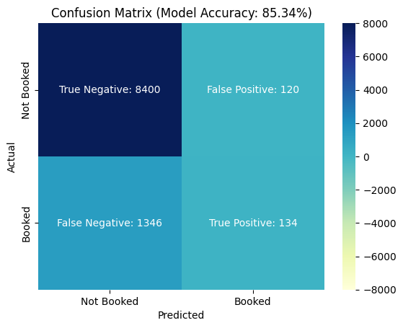
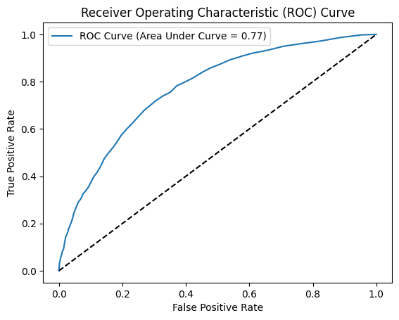
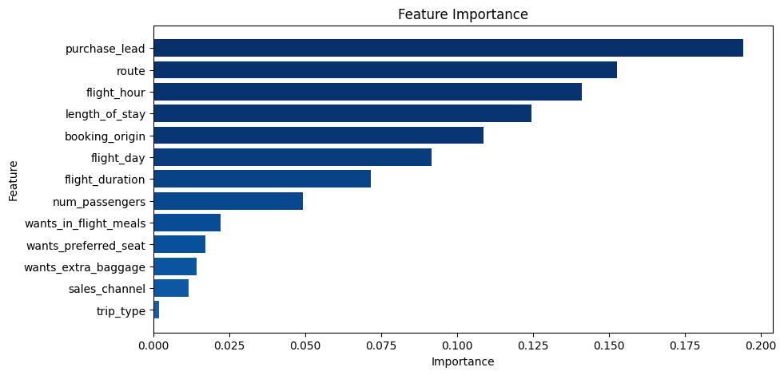
Findings and
Insights
Fig. 1: Confusion Matrix comparing the how many of the model’s positive and negative predictions were correct
Fig. 2: ROC Curve further illustrating model accuracy (Area Under Curve values closer to 1 are better)
Fig. 3: Chart comparing the importance of each feature of the dataset in making a correct prediction

